Slide 2
10 years IPMA YOUNG CREW

Slide 3
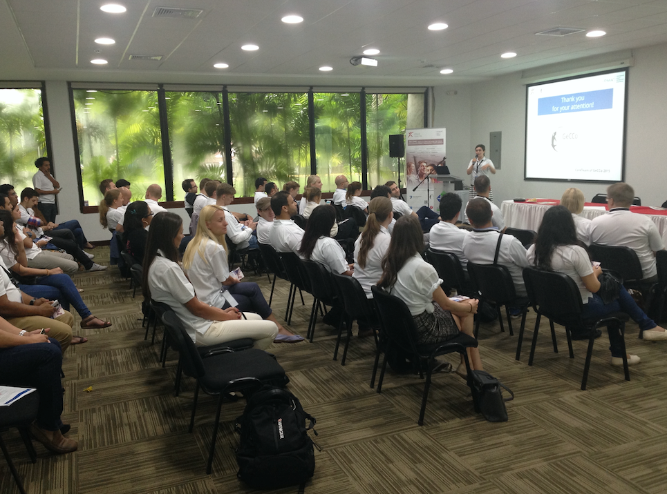
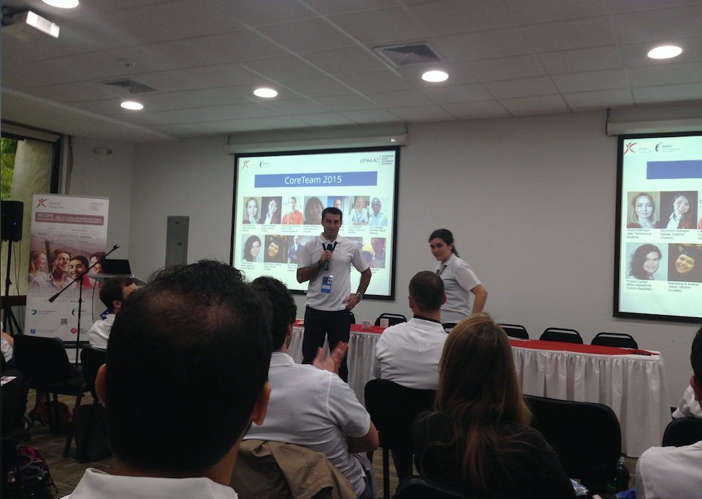
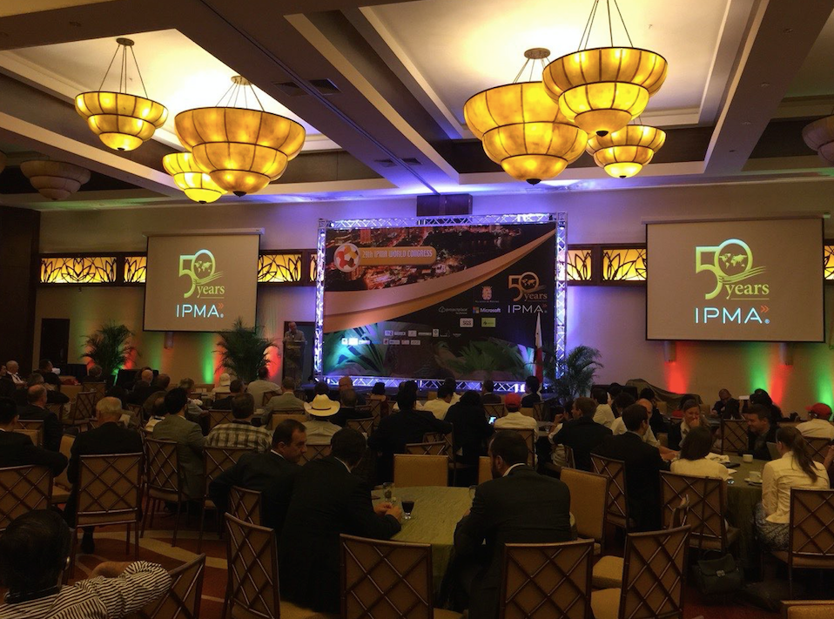
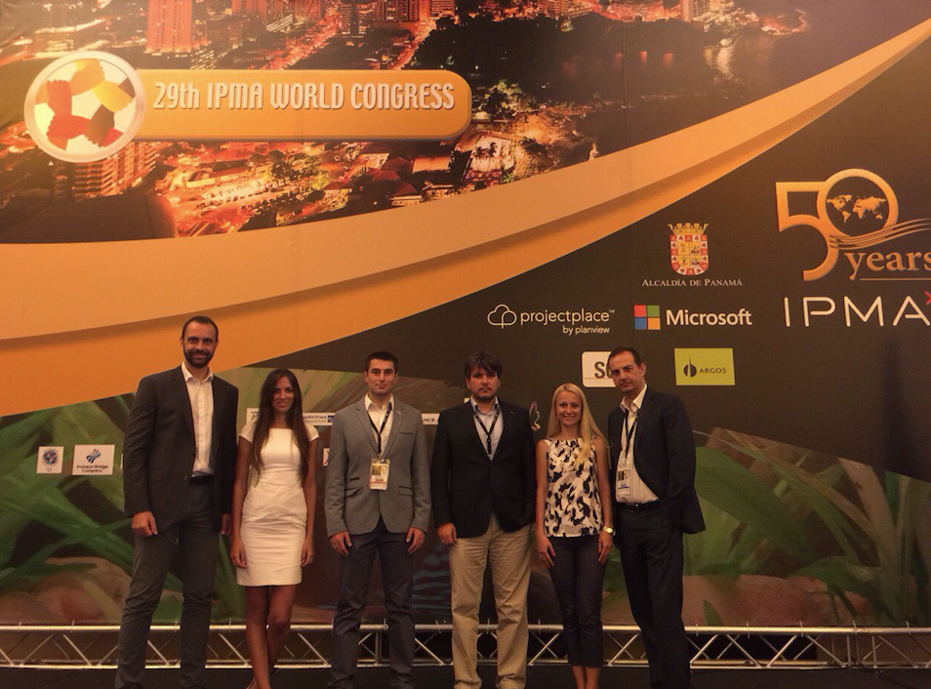

Slide 4
What is PMC?
Project Management Championship is a competition between student teams to determine the best new or potential project managers
Objectives of competition include raising awareness of professional PM and the PM community, getting students involved in PM and test the PM skills in a fun way.
The competition is organized locally in two rounds: qualification and final.

Slide 5
What is THE IDEA?
The ultimate goal is to build globally recognized international project management competition for students (iPMC), where the best students – young project managers – are assessed within IPMA network.
IPMC is a tournament for students of universities from all over the world. In this tournament students compete based on project management competencies.
The plan is to have the second iPMC in 2016.

Slide 6
Schedule and timing
Qualification round (test) – 21st February 2016.
Case study (project plan proposal) – 28th February 2016.
International Project Management Competition – 17th March 2016.

Slide 7
Qualification day – 21st February
100 minutes and 100 questions
The results of the qualification round will be published on the 23rd of February
Six teams with the highest score will be invited to the Serbian Project Management Championship’s

Slide 8
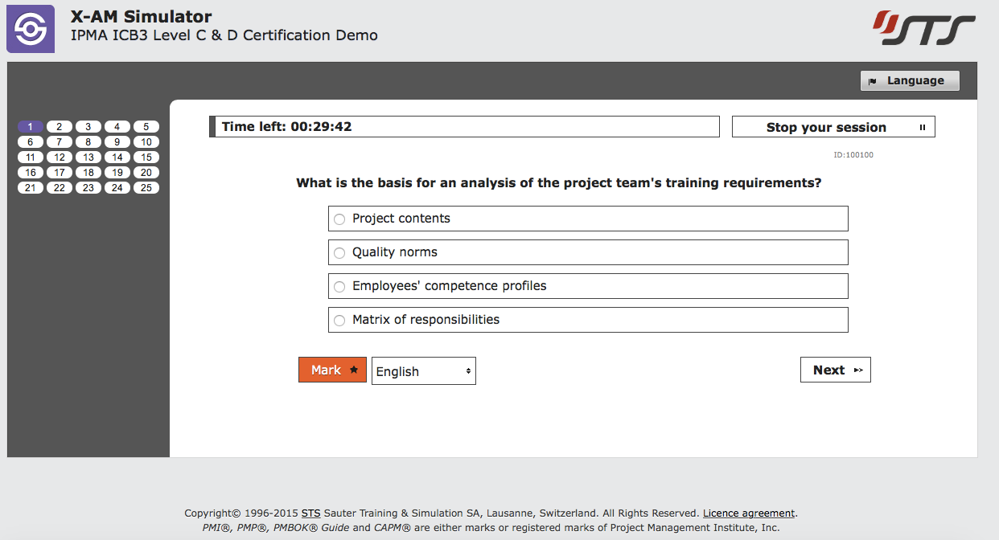

Slide 9
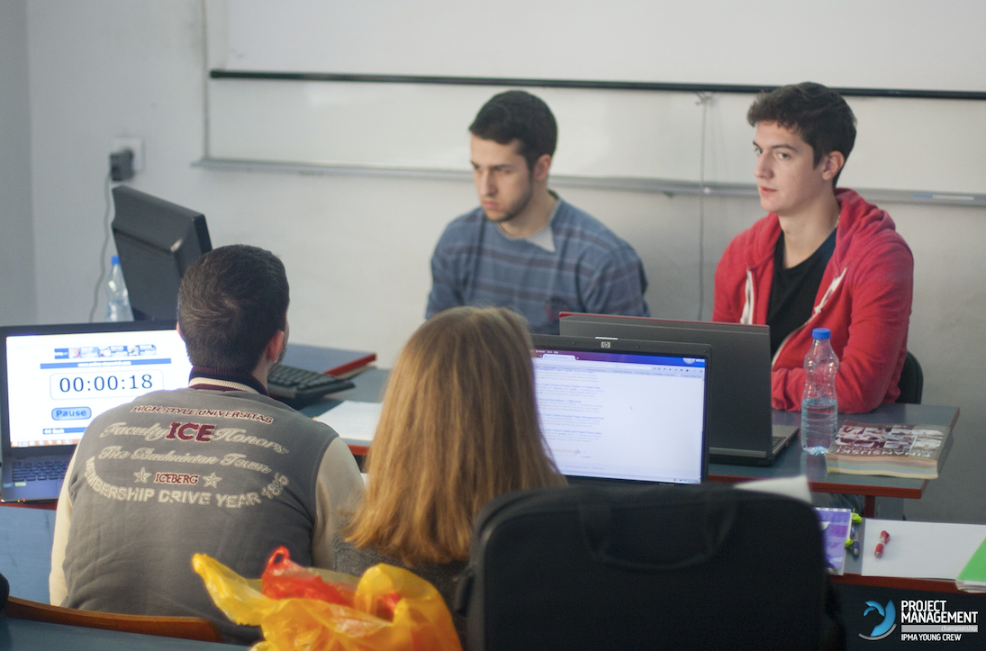
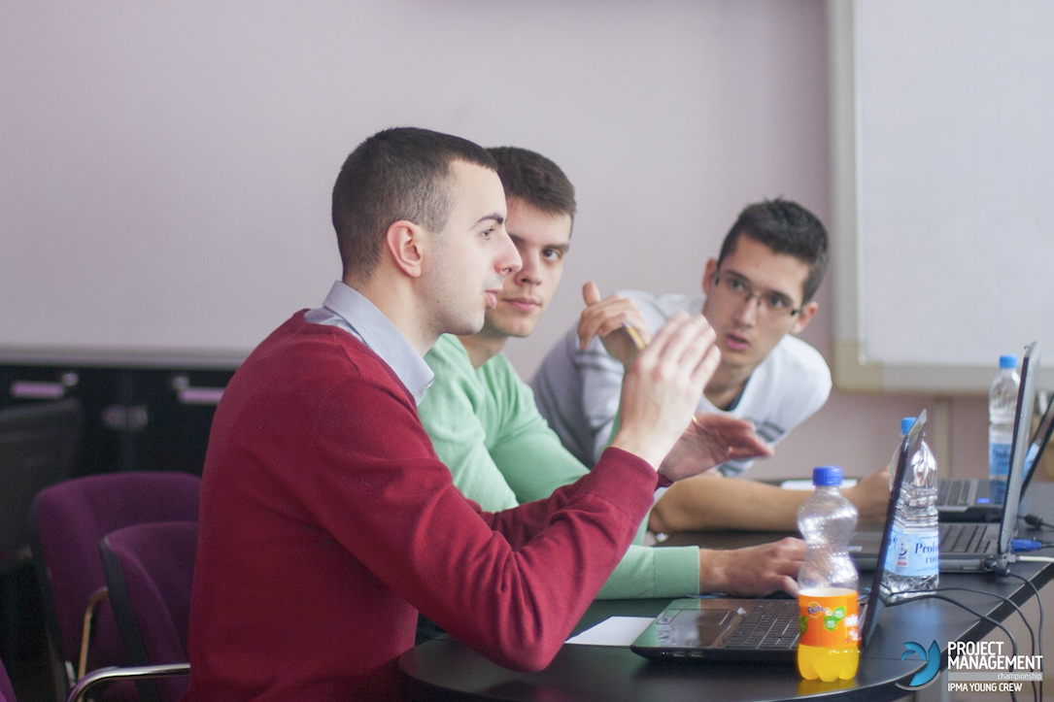
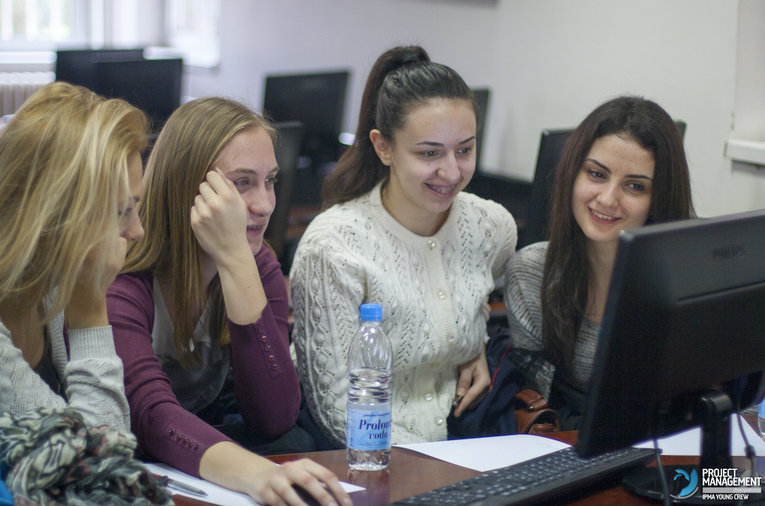
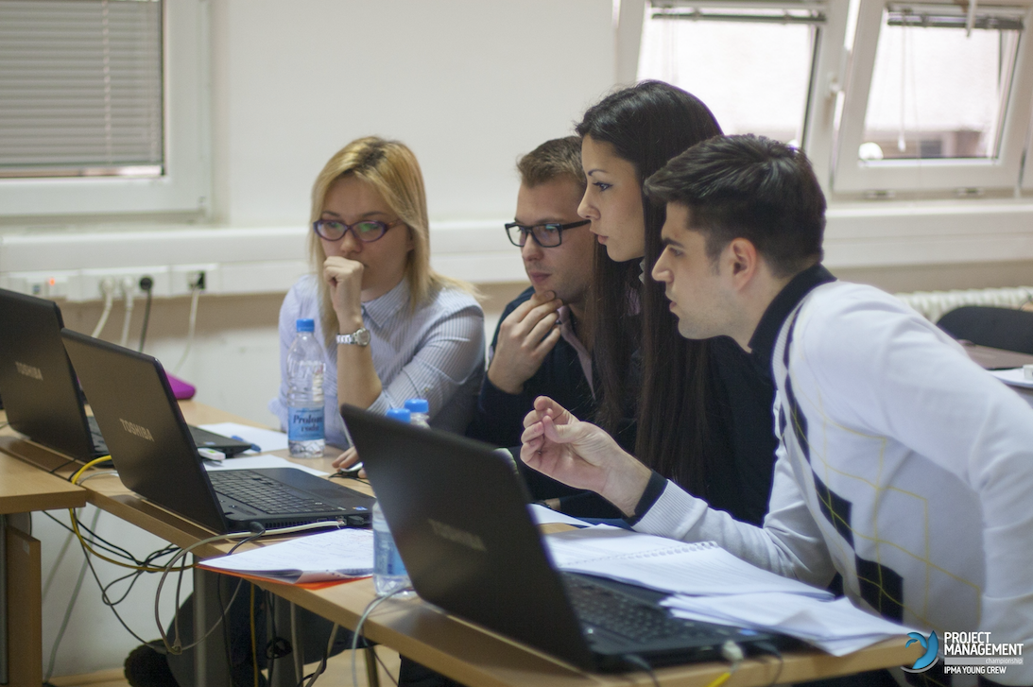

Slide 10
Final – 28th February
Project plan/Case study
The winning team will be invited to the biggest professional Project Management event in Baltics – the Baltic PM Days 2016 that will take place in The National Library of Latvia
Represent Serbia in the International PM Championship’s final on the 17th of March
Chance to take exam for IPMA level D certification

Slide 11
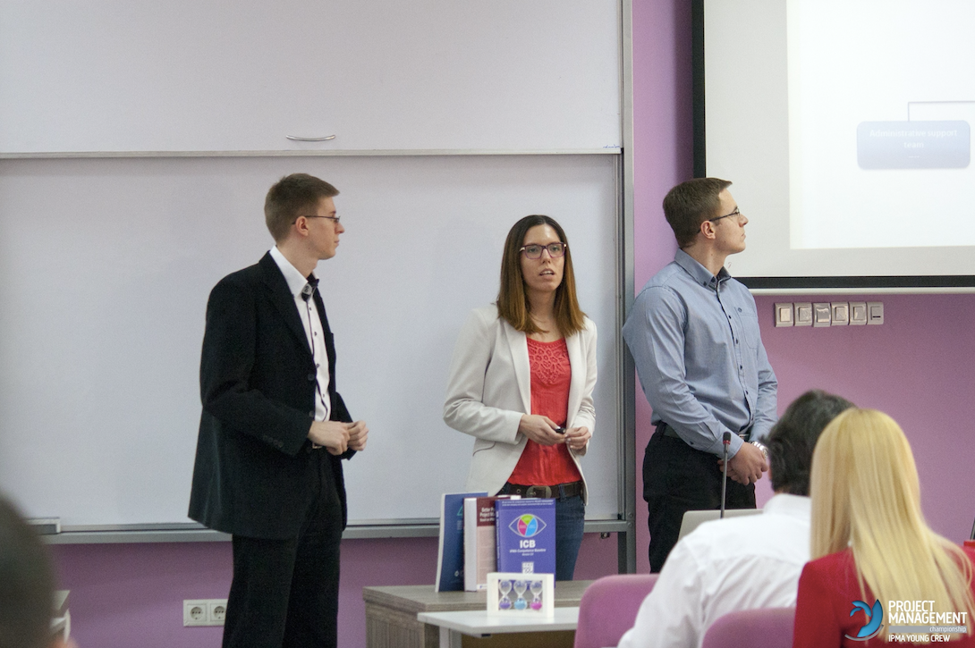
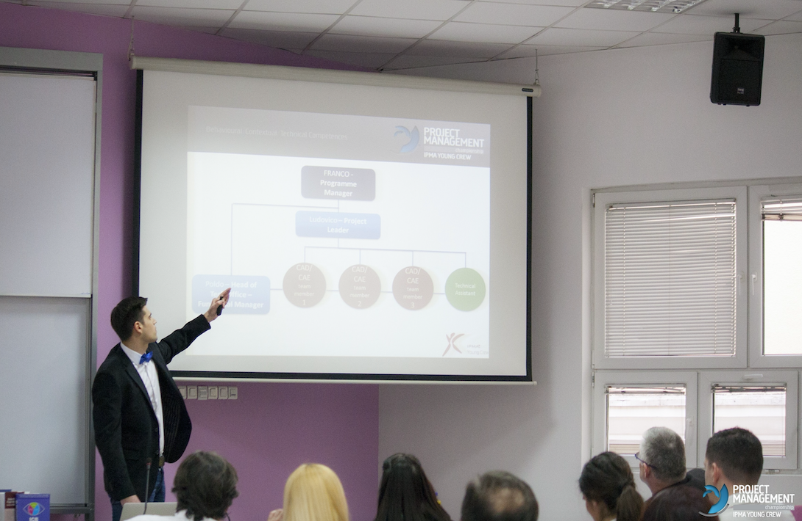
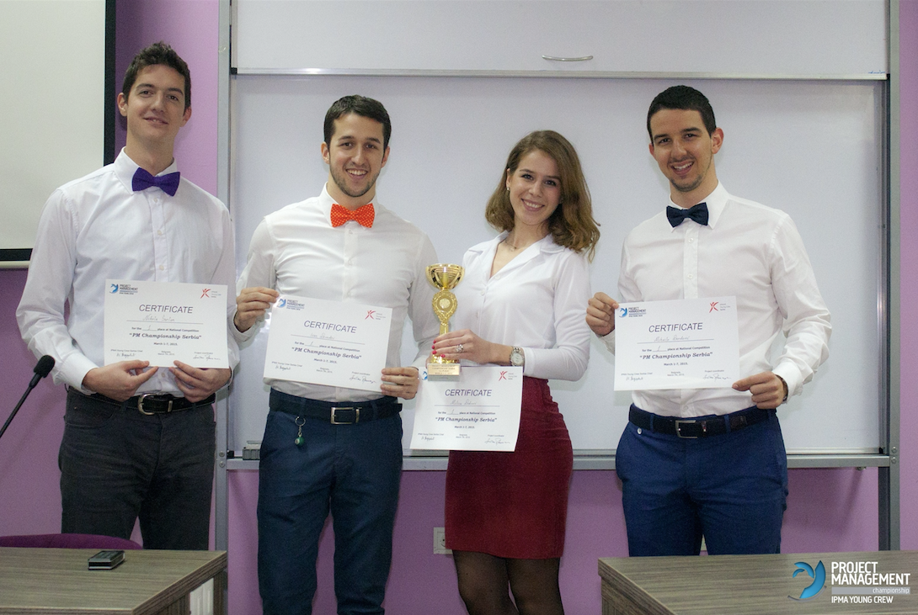

Slide 13
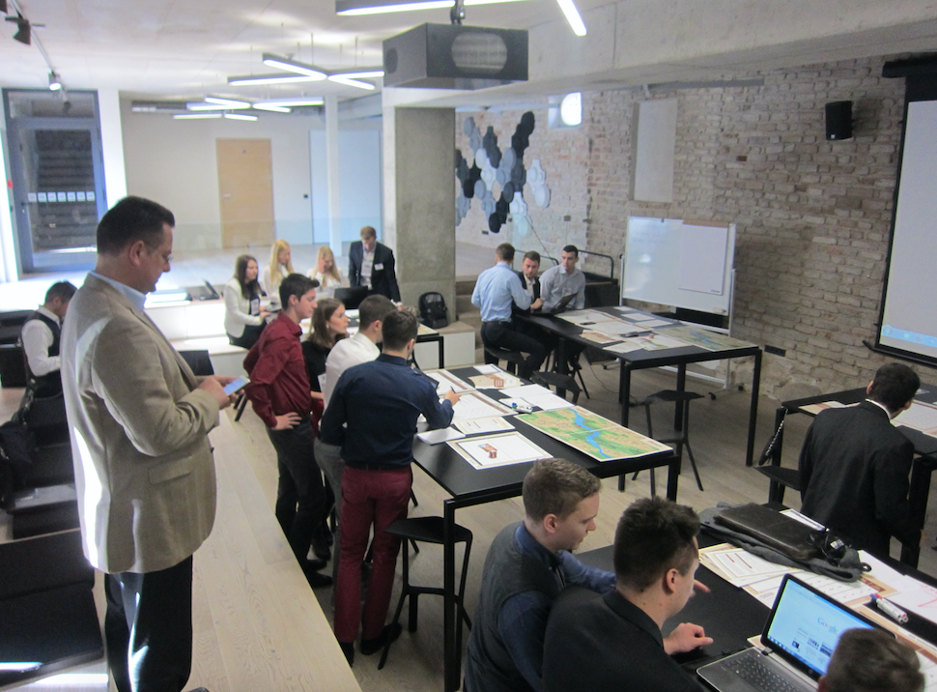
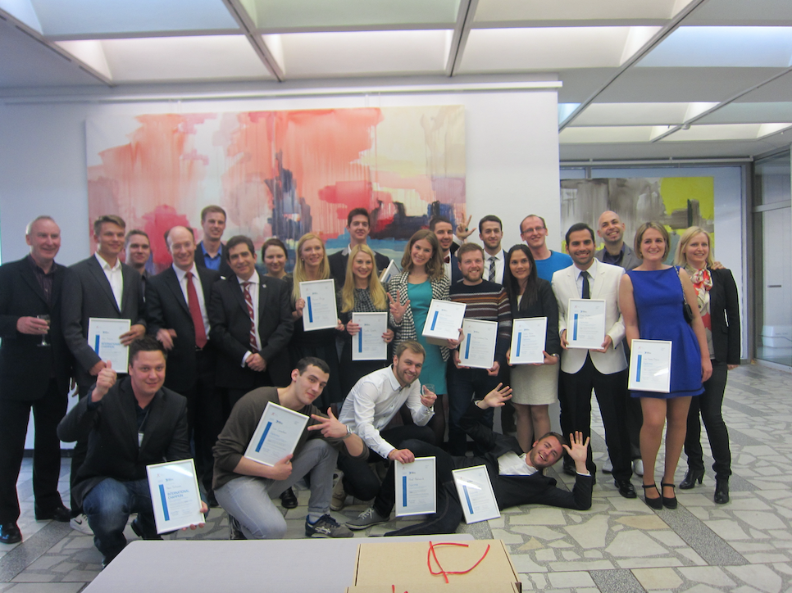
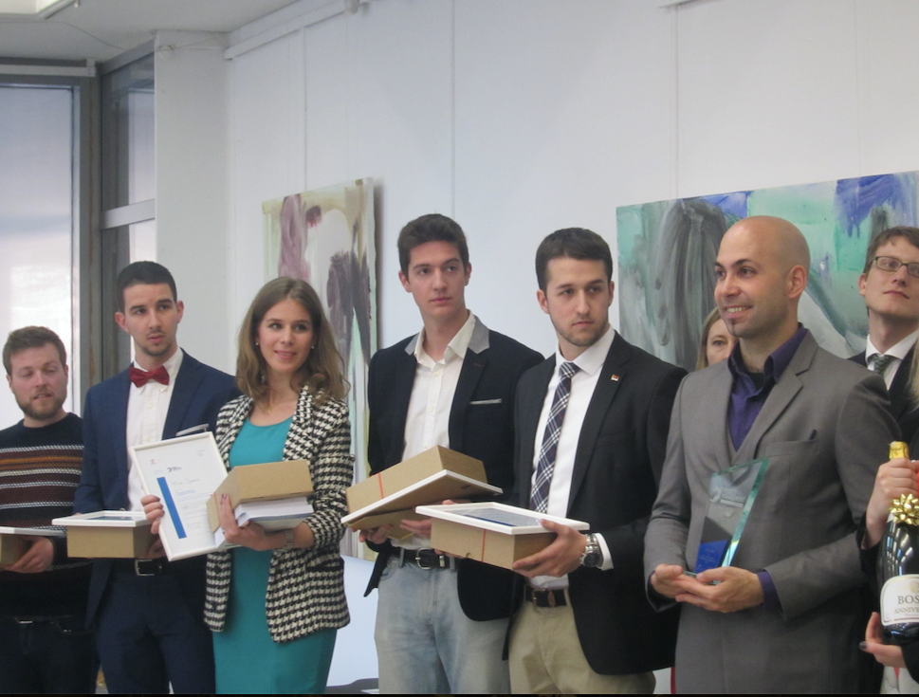

Slide 14
Why students should participate?
Test their PM skills against other students
PMC can be a way to start the career
Get noticed in PM community in the particular country
Learn more about PM in a fun way and learning-by-doing
Chance to meet and show oneself in front of internationally recognized experts in the field
Option to gain respectable record for one’s CV
Get valuable prizes

Slide 15
Getting involved?

Slide 16
http://www.become.pm/projectmanagementchampionships/
Contacts

Slide 17
